Slide 1

Streaming Data
Dima Ionut Daniel

Slide 2
Contents
What are Real-time systems ?
Architecture
Collecting Data
Message Queue
Analysis Tier
Storing Data
Data Access
Bibliography

Slide 3

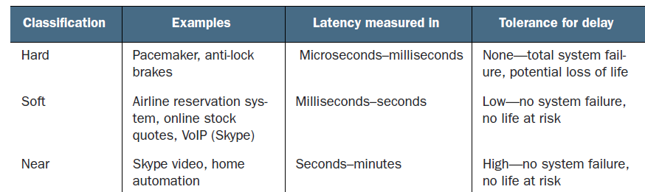
What are Real-time systems ?
A real-time system has been described as one which "controls an environment by receiving data, processing them, and returning the results sufficiently quickly to affect the environment at that time."
Real-time systems are classified as hard, soft, and near.

Slide 4
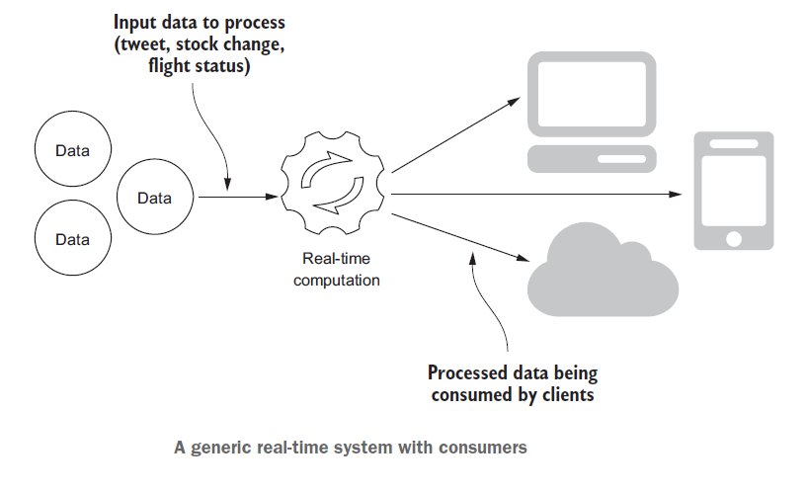
What are Real-time systems ? (cont.)

Slide 5
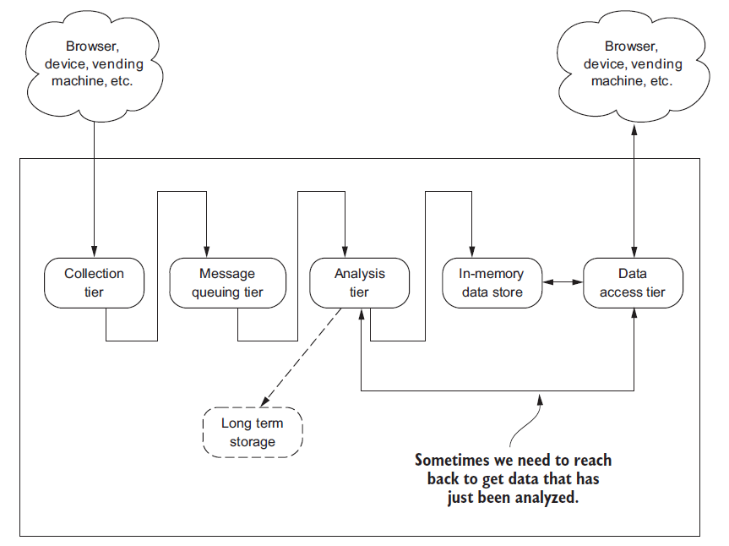
Architecture

Slide 6
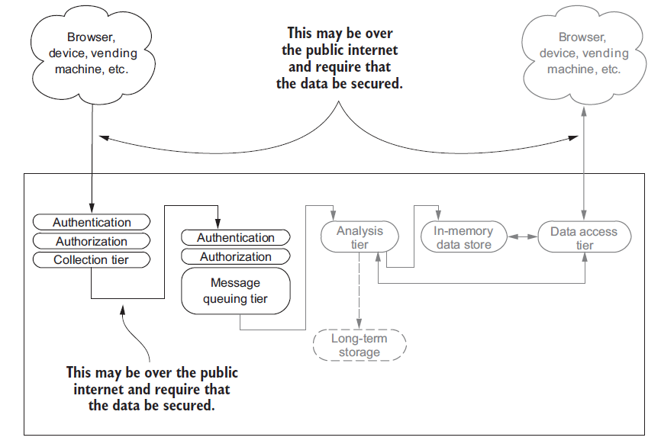
Architecture (cont.)

Slide 7
Collecting Data
The collection tier is our entry point for bringing data into our streaming system.
Interaction patterns:
Request/response pattern
Publish/subscribe pattern
One-way pattern
Request/acknowledge pattern
Stream pattern

Slide 8
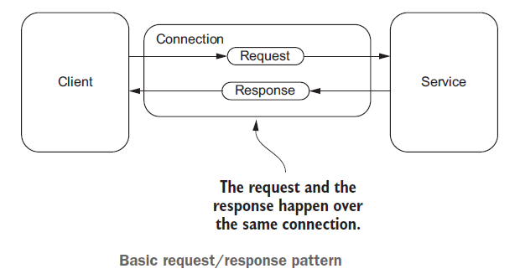
Collecting Data (cont.)
Request/response pattern is used when the client must have an immediate response or wants the service to complete a task without delay.

Slide 9
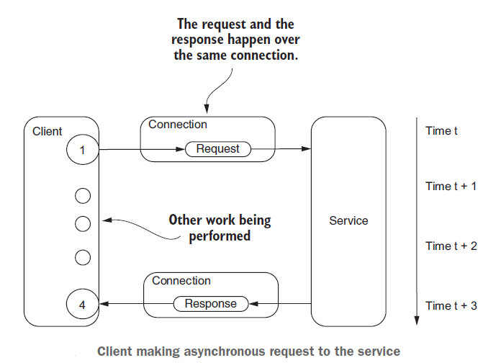
Collecting Data (cont.)
Sometimes client makes the request and then continues on with other processing while the service is processing the request.
This pattern is called half-async because one half of the request response is done asynchronously.

Slide 10
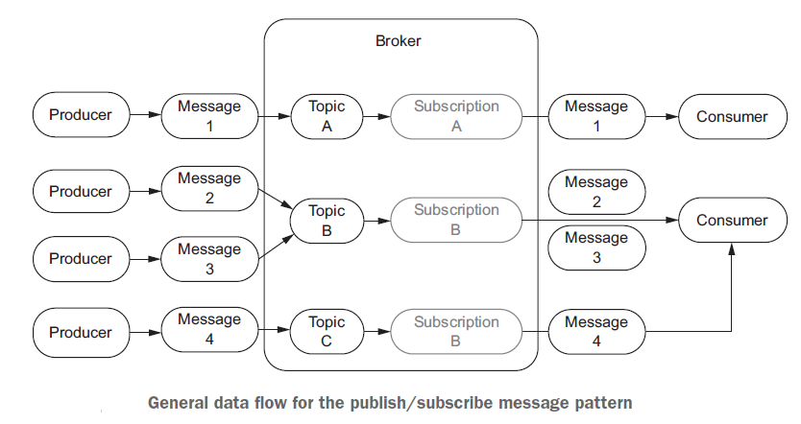
Collecting Data (cont.)
Request/acknowledge pattern is used when we need an acknowledgement that the request was received.
Publish/subscribe pattern is a common for message based data systems.
The messages are often sent to a topic and the message is sent to all the consumers subscribing to the topic.
By using the publish/subscribe pattern we’re able to decouple the sender of the data from its consumer.

Slide 11
Collecting Data (cont.)
One-way pattern is used in cases where the client that makes the request doesn't need a response.
The pattern is called also "fire and forgot".
The major difference is that the service doesn't send back a response.
With the one-way pattern the client doesn't know whether the request was received by the service.

Slide 12
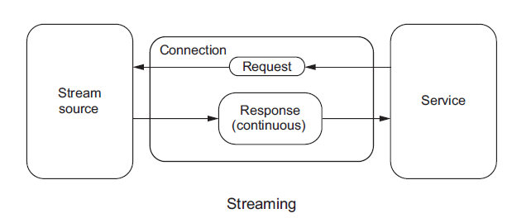
Collecting Data (cont.)
With stream pattern the client makes a request to a service that may or may not return a response.
The service becomes the client.

Slide 13
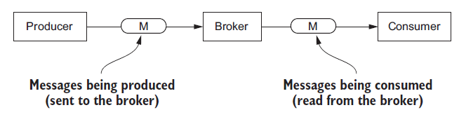
Message Queue
Common message services are RabbitMQ, ActiveMQ, HornetQ, ZeroMQ, Kafka.
Message queue has 3 components: producer, broker and consumer.

Slide 14
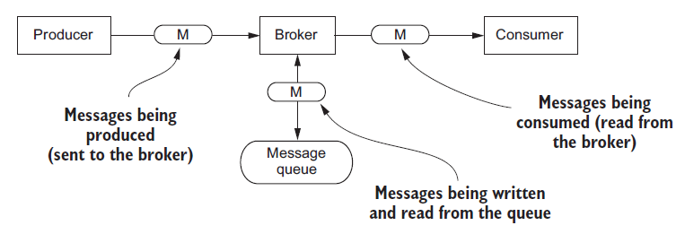
Message Queue (cont.)
The broker is not the message queue.
The producer sends a message to a broker.
The broker puts the message into a queue.
The consumer reads the message from the broker.

Slide 15
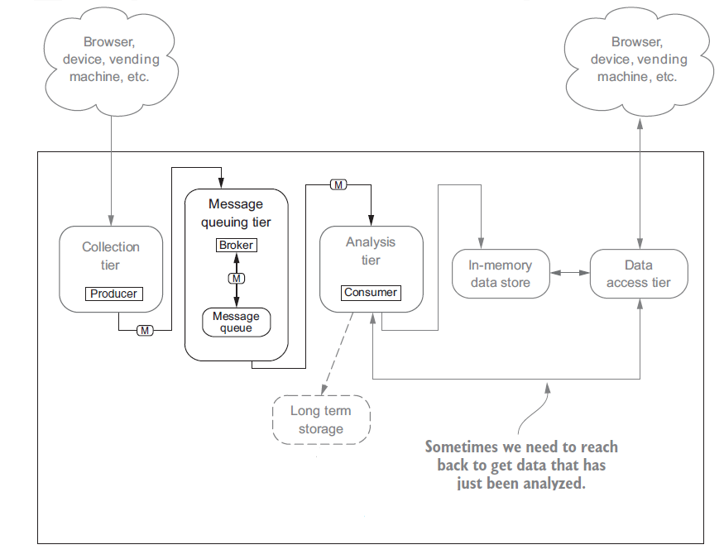
Message Queue (cont.)

Slide 16
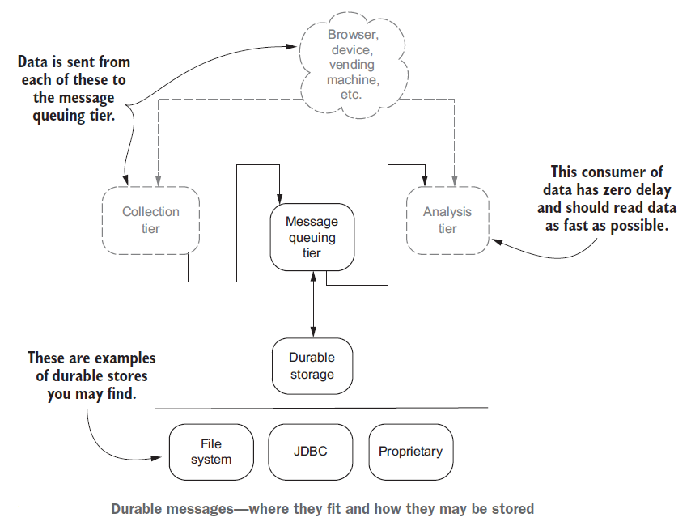
Message Queue (cont.)

Slide 17
Message Queue (cont.)
The producer sends messages to a broker and the consumer reads messages from the broker.
There are 3 common semantic guarantees specific to message queue products:
At most once: message may get lost, but it will never be reread by a consumer.
At least once: message will never be lost, but it may be reread by a consumer.
Exactly-once: message is never lost and is read by a consumer once and only once.

Slide 18
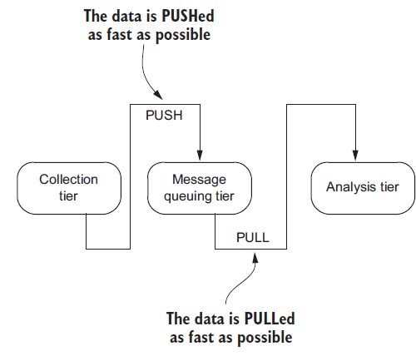
Analysis Tier
The analysis tier is designed to gather data from the collection tier and make it available to be moved through the rest of the streaming architecture.
This model is called the continuous query model, meaning the query is constantly being evaluated as new data arrives

Slide 19
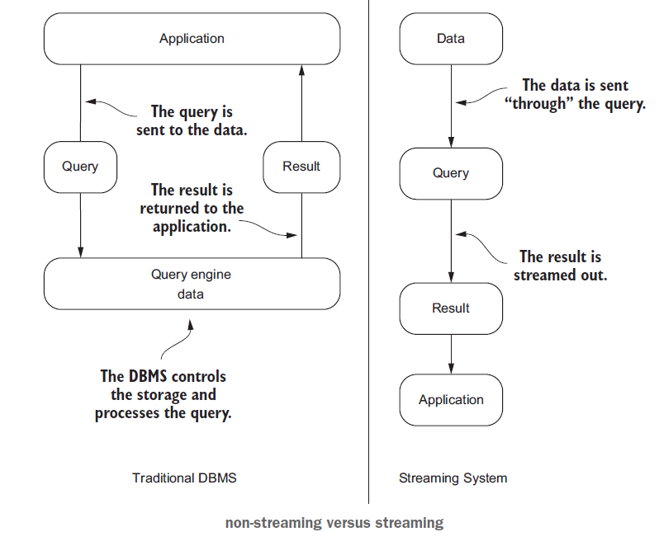
Analysis Tier (cont.)

Slide 20
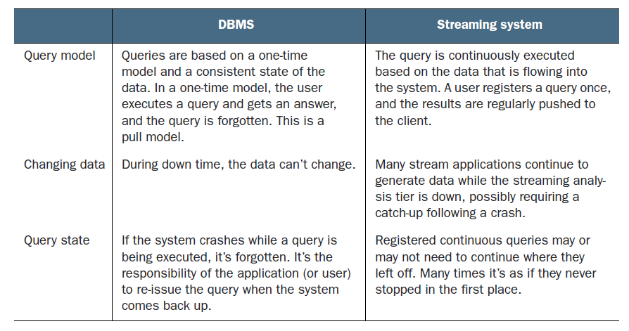
Analysis Tier (cont.)

Slide 21
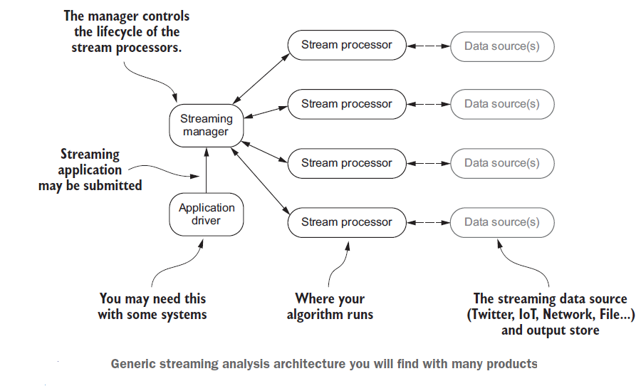
Analysis Tier (cont.)

Slide 22
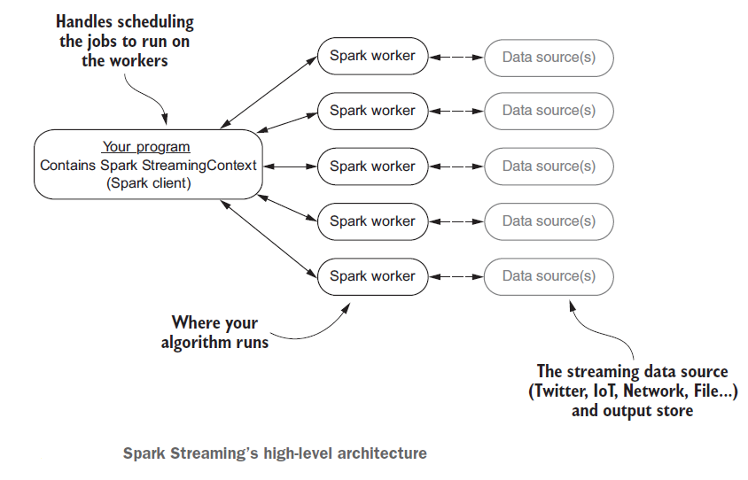
Analysis Tier (cont.)

Slide 23
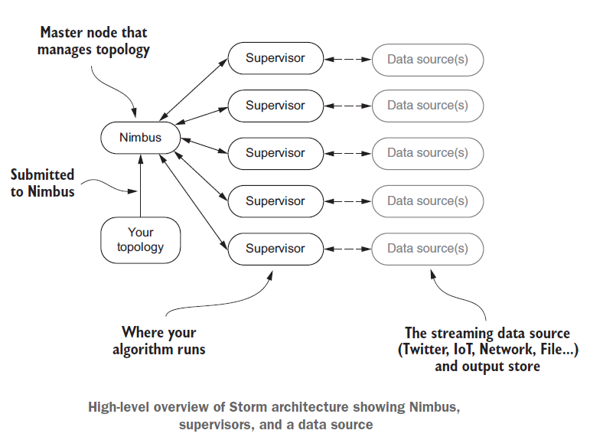
Analysis Tier (cont.)

Slide 24
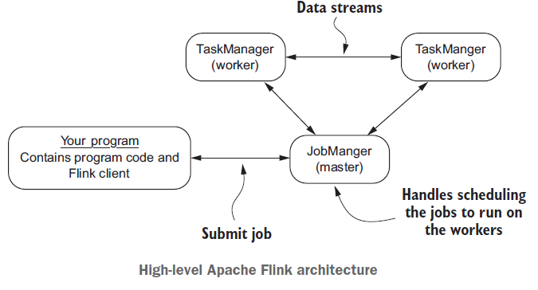
Analysis Tier (cont.)

Slide 25
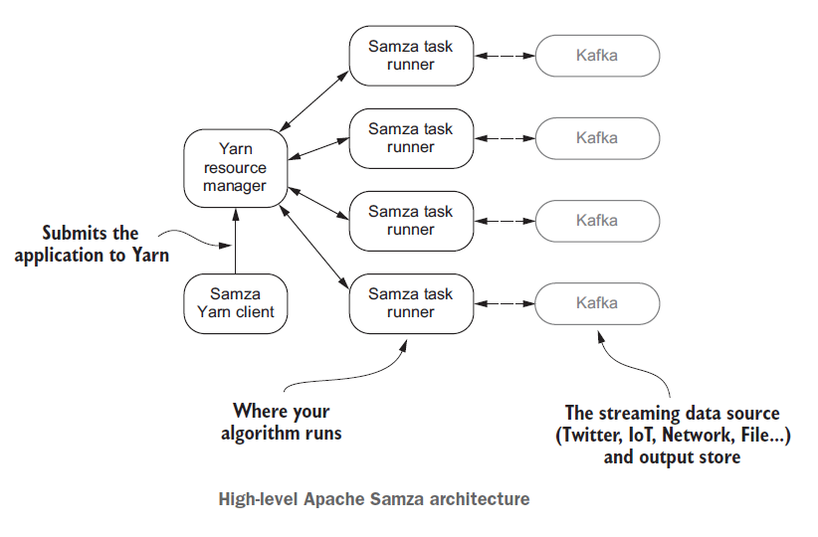
Analysis Tier (cont.)

Slide 26
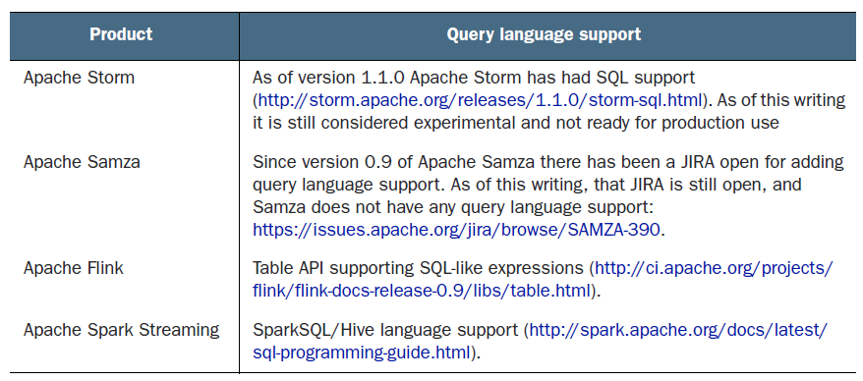
Analysis Tier (cont.)

Slide 27
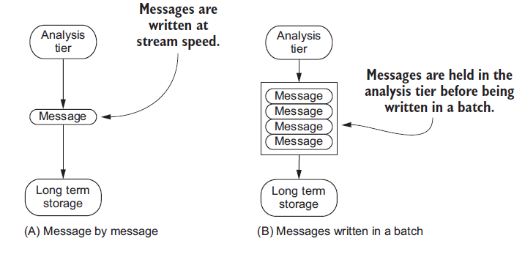
Storing Data
There will be times when we need to have the data you’re processing in your streaming system stored in a storage system designed for a non-streaming scenarios

Slide 28
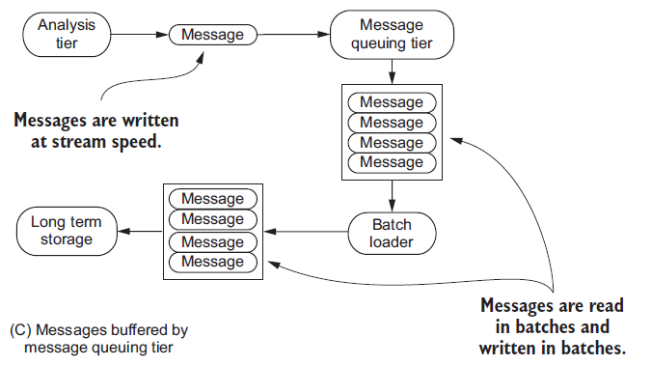
Storing Data (cont.)
Writing to Amazon S3, HDFS, HBase, or many traditional RDBMSes would be considered writing to a non-streaming data store.

Slide 29
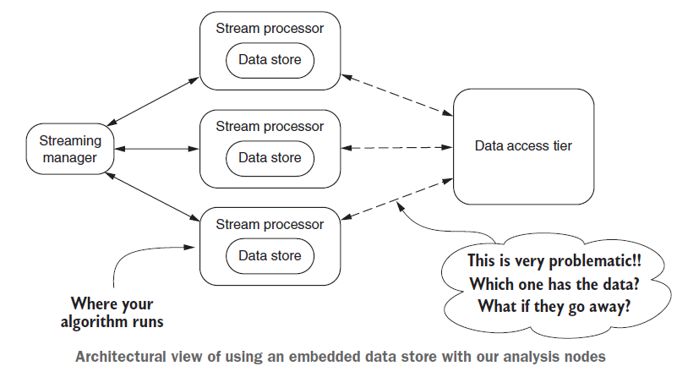
Storing Data (cont.)
When building a streaming analysis system, the goal is to be able to take action on the data in real time.

Slide 30
Storing Data (cont.)
The embedded data store will live on the same node as the stream processor.
The stream processor nodes are performing many roles stream processing, local data storage, and serving data to a data access tier.
Storage products: SQLite, RocksDB, LevelDB, LMDB, Perset.

Slide 31
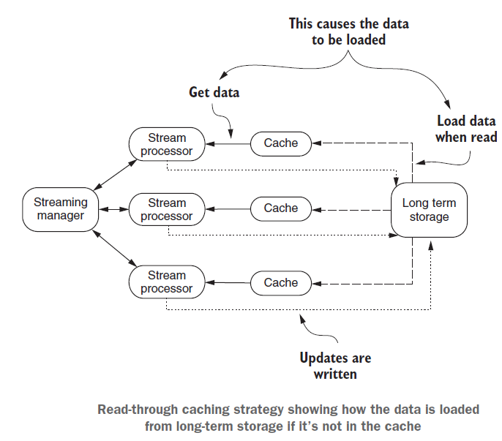
Storing Data (cont.)
With the read-through strategy the caching system reads data from a persistent store when it’s asked for a cached entry that isn’t in the cache.

Slide 32
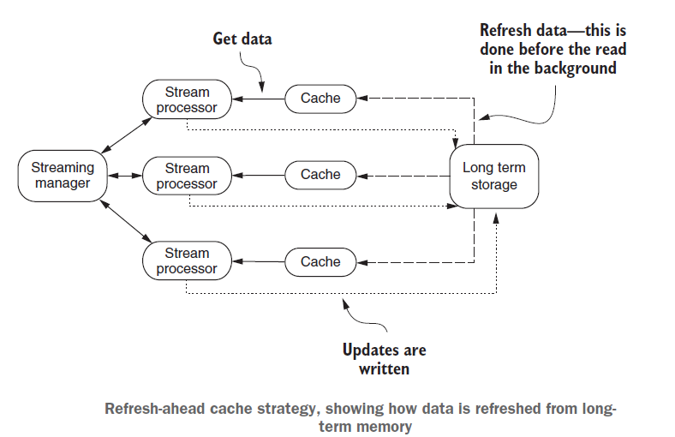
Storing Data (cont.)
The goal of refresh-ahead strategy is for the cache to refresh recently accessed data before it’s expired and evicted.
Keeping this level of fine-grained coordination may be hard to do with a stream of data.

Slide 33
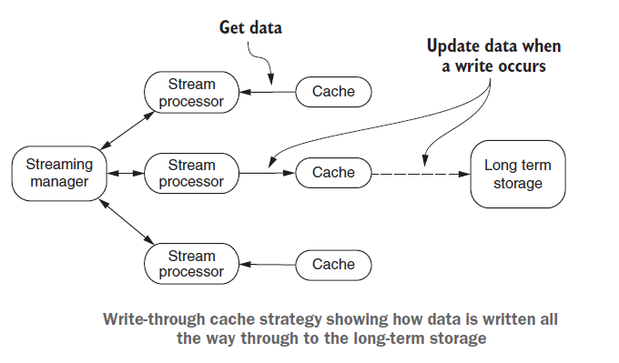
Storing Data (cont.)
This write-through strategy has the caching system write updated data through to the backing store, eliminating the need for an out-of-band process to write data to the backing store or load changes into the cache.

Slide 34
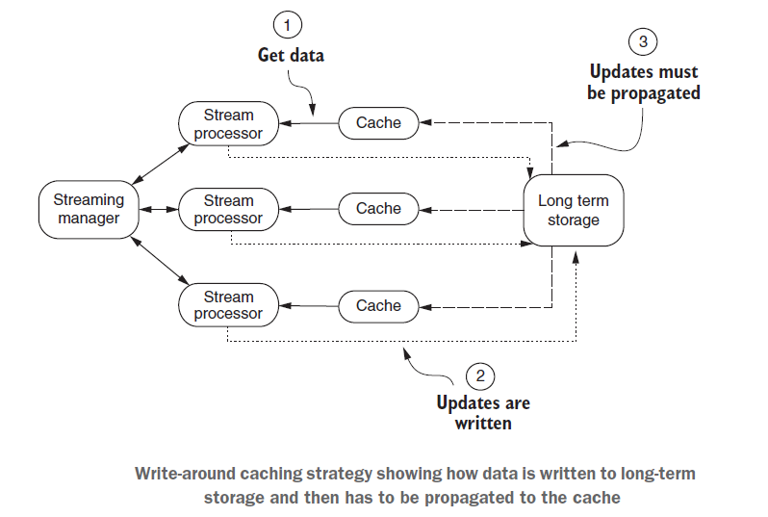
Storing Data (cont.)
With write-around strategy the idea is that the process of updating a persistent store that the cache is representing happens out of band of the cache. Out of band refers to the updating of the cache happening in the background.

Slide 35
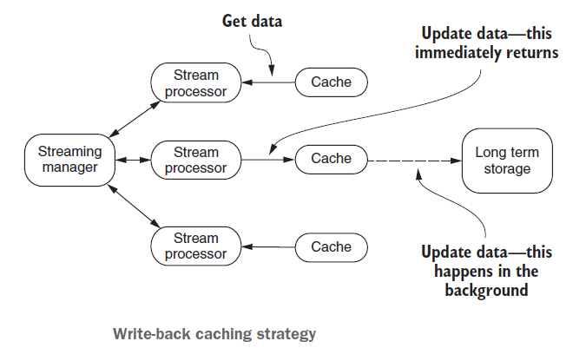
Storing Data (cont.)
With write-back strategy, the caching system eventually writes the new data to the persistent store. Unlike write-through, where the data is immediately written, with write-back the write to the cache is acknowledged, and then in the background the updated or new data is written to the persistent store.

Slide 36
Storing Data (cont.)
Some systems in this space, such as EHCache, do provide ways of extending it to support read-through, write-through, and write-behind functionality.
Common caching products: Memcached, EHCache, Hazelcast, Redis.

Slide 37
Storing Data (cont.)
In-memory databases (IMDBs) are sometimes called in-memory database management systems and in-memory data grids (IMDGs).
Unlike the caching systems, IMDBs and IMDGs are designed to use disk for the non-volatile persistence of data.
Common products: MemSQL, VoltDB, Aerospike, Apache Geode, Couchbase, Apache Ignite, Hazelcast, Infinispan.

Slide 38
Data Access
We need to support pushing data to a client and/or the client pulling data from our API.
Beyond generic push or pull, there are 4 common patterns: Data Sync, RMI/RPC, Simple Messaging, and Publish-Subscribe.

Slide 39
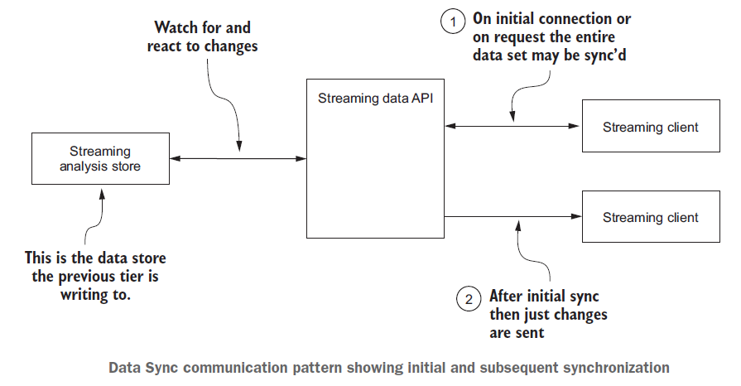
Data Access (cont.)
The streaming API watches (there may be a notification mechanism) for changes to the data store the analysis tier is writing to and then sends the updates to the streaming client.

Slide 40
Data Access (cont.)
Benefits
Simple protocol.
The client has a complete data set.
The client always has a consistent view of the data that is the most current.
Drawbacks
The data set may be large and require significant bandwidth to transfer.
The data set may not fit on the device it is being transferred to.
Need to resolve data version conflicts.
Need to determine a merge policy so you know how to handle data changes made by the client with those made by the server.

Slide 41
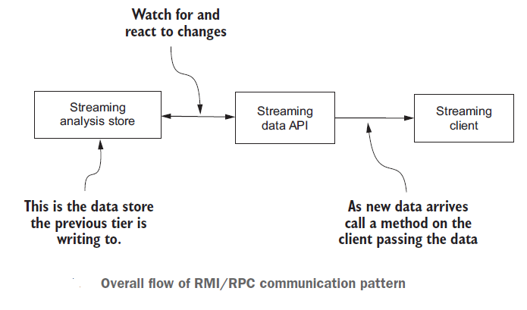
Data Access (cont.)
With the Remote Method Invocation (RMI)/Remote Procedure Call (RPC) communication pattern, the API server invokes or calls a method on a connected client when new data arrives or when a condition is met that is of interest to the client.

Slide 42
Data Access (cont.)
Benefits
Simple protocol.
Client can perform other processing and then react when a handler is called.
Drawbacks
Detecting failures is hard—what if the client isn’t available? How can the client know the server didn’t receive new data?
Frequency of updates may overwhelm a client.
How does the API handle client failures?

Slide 43
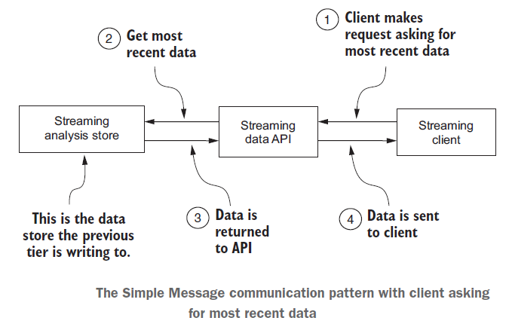
Data Access (cont.)
With the Simple Messaging communication pattern the client initiates a request to the streaming API asking for the most recent data, and the API responds with the latest data.

Slide 44
Data Access (cont.)
Benefits
Simple protocol and API call for the consumer to make.
Only the most recent data is sent to the client.
The client only has to keep track of a little metadata to continue getting the most recent data.
The API doesn’t have to keep track of any client state.
Drawbacks
The protocol can be chatty because the client may continue making constant calls for the new data.
There is no mechanism to alert the client to the existence of new data.
The payload of new data may be large if the client was offline for an extended period of time or the velocity of the data is large.

Slide 45
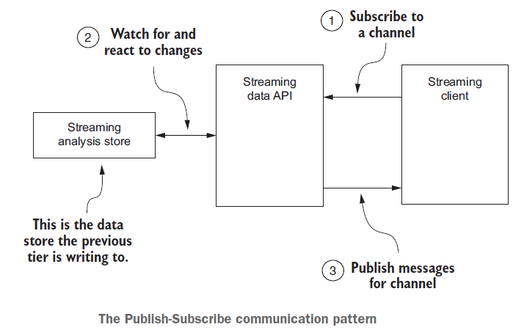
Data Access (cont.)
With the Publish-Subscribe pattern the client subscribes to a particular channel, and the API then sends messages to all clients subscribed to that channel when the data changes.

Slide 46
Data Access (cont.)
Benefits
The client can perform other processing and then react when data arrives.
The client doesn’t need to maintain any metadata about the current data.
The API can optimize how it handles sending data to multiple clients.
Drawbacks
There’s a more complex protocol for the API.
The API has to keep track of all metadata related to the clients, and must have the ability to distribute this across API servers in the event of a failure.

Slide 47
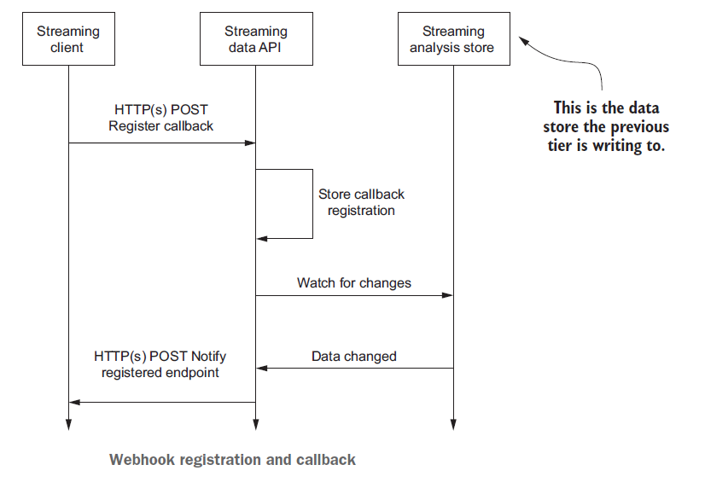
Data Access (cont.)
Webhooks have been around since 2007. Though not an official W3C standard, they’ve been adopted by many as a way for a client to register a user-defined HTTP endpoint to be called when new data arrives or a condition is met.

Slide 48
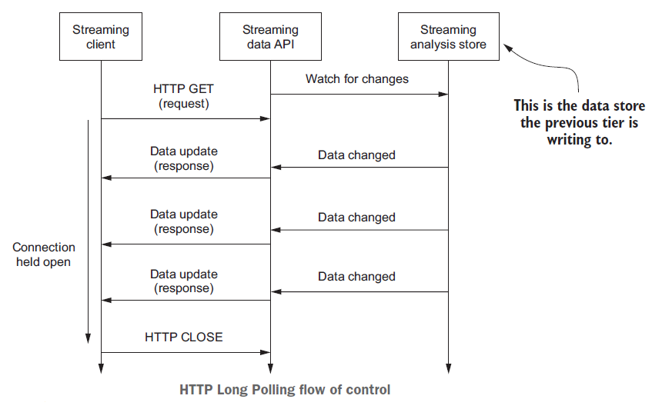
Data Access (cont.)
HTTP Long Polling involves the client making a connection to the server (in this case the streaming API server), the connection being held open, and the data being sent to the client as it is available.

Slide 49
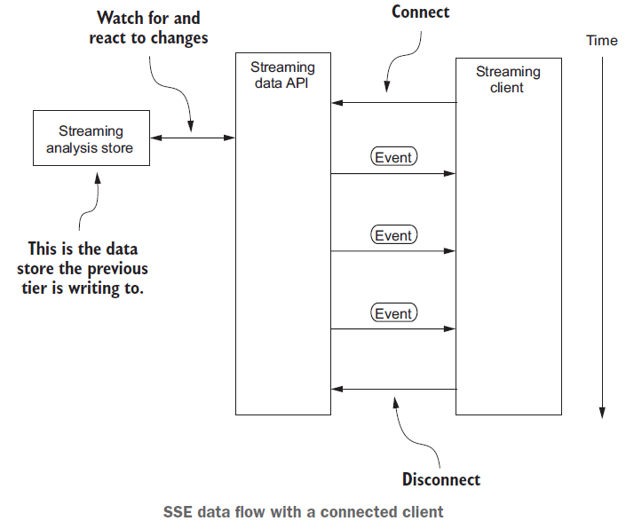
Data Access (cont.)
Server-sent events (SSE) was developed and the subsequent W3C recommendation established in 2015 as an improvement over HTTP Long Polling.

Slide 50
Data Access (cont.)
Unlike Long Polling, where the connection is closed and reopened for every message, in this case all the events are sent over the same connection.
This results in more efficient network utilization and allows the client to do other processing while waiting for events to arrive.
This still requires a client to maintain the connection, though.
The second mode that SSE supports is connectionless push.

Slide 51
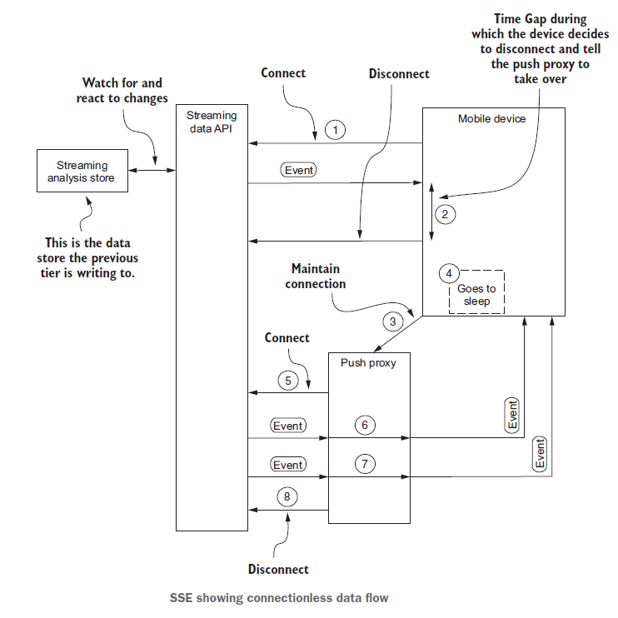
Data Access (cont.)

Slide 52
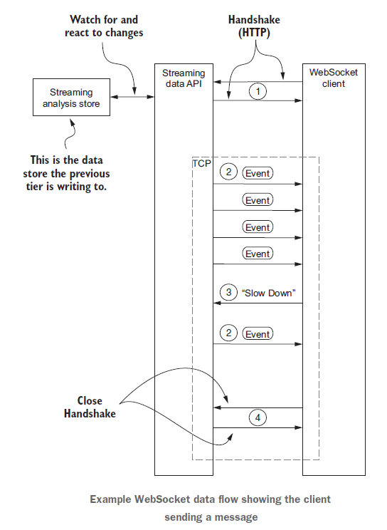
Data Access (cont.)
WebSockets has been around since 2011.
It’s a full-duplex protocol that uses TCP for the communication transport.
All major desktop and mobile browsers support it.

Slide 53
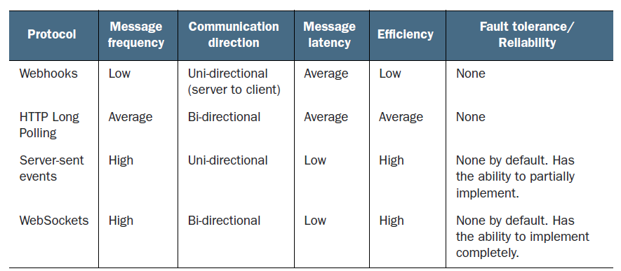
Data Access (cont.)

Slide 54
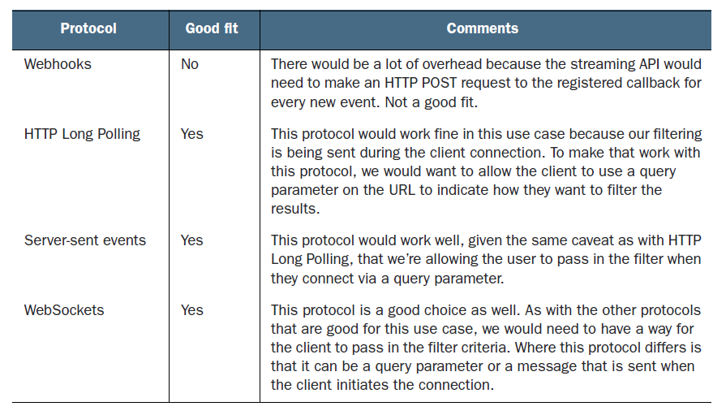
Data Access (cont.)

Slide 55

Bibliography
https://en.wikipedia.org/wiki/Real-time_computing
Manning – Streaming Data

